Slide 1

A Predictive Analysis of Loan Approval with the Integration of Mental Health Data using Machine Learning and Deep Learning Algorithms
Presented by: Oluwatosin Peter Ajana

Slide 2
Introduction
A loan is a vital component of an economy's expansion. Financial institutions such as banks mostly rely on interest on loans as their primary source of income (Kumari et al 2023).
Banks and other financial institutions evaluating a few crucial characteristics of applicants before granting loan. These includes; loan amount, credit history, applicant(s) income (Uddin et al. 2023).
Previous studies have demonstrated a strong relationship between mental health and financial stability as well as the relative influence of mental health conditions on financial decisions.
Statistics shows that only 28% of people without mental health conditions struggle with money management, whereas roughly 56% of people with mental health issues have trouble managing their credit (Vos et al. 2020).
Problem Statement
The combination of deep learning and machine learning techniques has significant promise for enhancing decision-making within the predictive analysis of loan approval. Previous studies have investigated using machine learning algorithms to predict loan approval, but they failed to address the biases that are inevitably present in the unbalanced dataset and did not consider the interpretability of the models.
Research Gap
Therefore, the two main areas of unmet research need are how to handle unbalanced data sets to improve the efficiency of the models and how to make the model's outputs interpretable. This gap poses critical challenges in understanding the factors driving loan approval decisions
Research Aim
To carry out a predictive analysis on loan approval process with the integration of mental health survey data using machine and deep learning algorithms.

Slide 3


Research Questions
Research Objectives
In this study, we would examine the following research questions:
To evaluate various machine learning techniques and neural network in determining the best model performance of prediction.
To address any imbalances in the dataset to enhance both the interpretability and performance of the models.
To evaluate the ethical consideration associated with the utilization of mental health data.
To establish a framework for future research in the improvement of models to develop a more accurate prediction.
Research Question 1
Research Question 2
How can loan approval accuracy be increased while still benefiting customers and financial institutions?
How can interpretability of models help researchers in the future understand how financial organisations like banks make decisions?

Slide 4



Literature Review
Kumar et al.(2022) used decision trees, KNN, random forests, support vector machines, and an ensemble model that included decision trees and adaboost classifiers to perform a credit risk analysis. With an accuracy of 84%, the ensemble model of decision tree with adaboost technique outperformed the other algorithms.
Uddin et al. (2023) used Nine machine learning models, including deep learning models like neural networks, recurrent neural networks, and long short-term memory models to predict loan approval, extra tree outperformed its competitors, obtaining an accuracy of 86.64%.
Alagic et al. (2024) carried out a loan approval dataset integrating a mental health survey data using seven machine algorithms. Xgboost performed best with 83% accuracy for the mental health survey data while random forest performed best with 85% for the loan approval dataset.

Slide 5
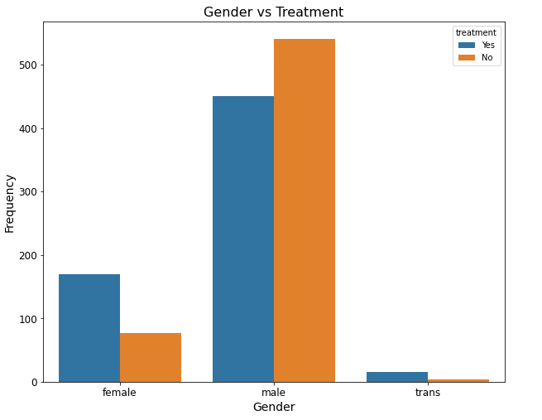
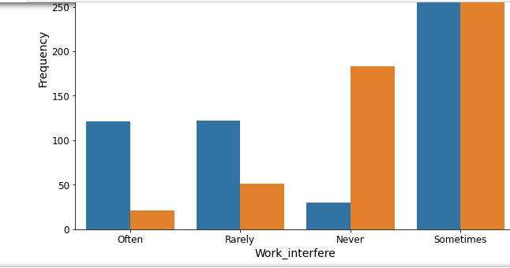
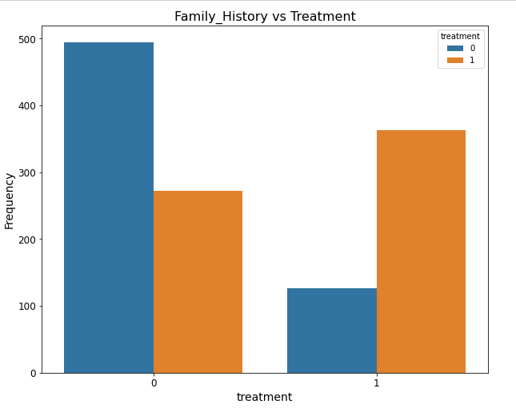
Methodology
Gender vs Treatment
Work Interfere vs Treatment
Family History vs Treatment

Slide 6


Answers to Research Questions
Research Question 1
Research Answer 1
Research Question 2
Research Answer 2
How can loan approval accuracy be increased while still benefiting customers and financial institutions?
Accuracy can be improved by handling the unbiased nature of the dataset
This does not only improve the efficiency of the model but also eradicate any form of bias, therefore benefiting the applicants and the bank.
How can interpretability of models help researchers in the future understand how financial organisations like banks make decisions?
By evaluating the feature importance analysis for each model, future researchers can understand the most important factor in the decision making of each model.

Slide 7
Result and Evaluation – Model Performance Comparison
Result Table for Loan Approval Dataset
Algorithms Used | Accuracy | Precision | Recall | True Pos | True Neg | False Pos | False Neg
Random Forest | 95.32% | 99.36% | 93.13% | 58.42% | 36.89% | 0.37% | 4.31%
Logistic Regression | 92.51% | 96.68% | 91.19% | 57.21% | 35.30% | 1.97% | 5.52%
Support vector machine | 93.82% | 98.09% | 91.94% | 57.68% | 36.14% | 1.12% | 5.06%
Naïve Bayes | 93.45% | 95.10% | 93.91% | 58.99% | 34.46% | 2.81% | 3.75%
Voting Classifier | 95.69% | 98.48% | 95.63% | 59.36% | 36.33% | 0.94% | 3.37%
K Nearest Neighbour | 91.67% | 93.16% | 93.58% | 58.71% | 32.96% | 4.31% | 4.03%
Random Basic Function | 53.28% | 63.09% | 61.49% | 38.57% | 14.70% | 24.16% | 22.57%
Multilayer Perceptron | 92.04% | 94.12% | 93.13% | 57.77% | 33.99% | 3.28% | 4.96%
Accuracy, Precision and Recall were all used to evaluate the model's performance but with accuracy as the main metric.
Voting classifier ensemble method, random forest and SVM were the most performing models with accuracy of 95.69%, 95.32% and 93.52% respectively
Random basic function is the worst performing model with an accuracy of 53.28%
Multilayer perceptron model performed better than KNN model

Slide 8
Result and Evaluation – Model Performance Comparison
Result Table for Mental Health Survey Dataset
Accuracy, Precision and Recall were all used to evaluate the model's performance but with accuracy as the main metric.
Random forest logistics regression and multilayer perceptron were the best performing models, with random forest having the highest accuracy of 74.92%
Multilayer perceptron model and logistics regression achieved same accuracy of 72.38% each
Random basic function is the worst performing model with an accuracy of 55.87%
Table 2: Results for the mental health survey dataset
Algorithms Used | Accuracy | Precision | Recall | True Pos | True Neg | False Pos | False Neg
Random Forest | 74.92% | 73.33% | 77.56% | 38.41% | 36.51% | 13.97% | 11.11%
Logistics Regression | 72.38% | 71.17% | 74.36% | 36.83% | 35.56% | 14.92% | 12.70%
Support Vector Machine | 71.75% | 73.76% | 66.67% | 33.02% | 38.73% | 11.75% | 16.51%
Naïve Bayes | 67.94% | 68.21% | 66.03% | 32.70% | 35.24% | 15.24% | 16.83%
Voting Classifier | 72.70% | 71.08% | 75.64% | 37.46% | 35.24% | 15.24% | 12.06%
K Nearest Neighbour | 69.52% | 70.55% | 66.03% | 32.70% | 36.83% | 13.65% | 16.83%
Radial Basic Function | 55.87% | 63.93% | 25% | 12.38% | 43.49% | 6.98% | 37.14%
Multilayer Perceptron | 72.38% | 71.17% | 74.36% | 36.83% | 35.56% | 14.92% | 12.70%

Slide 9
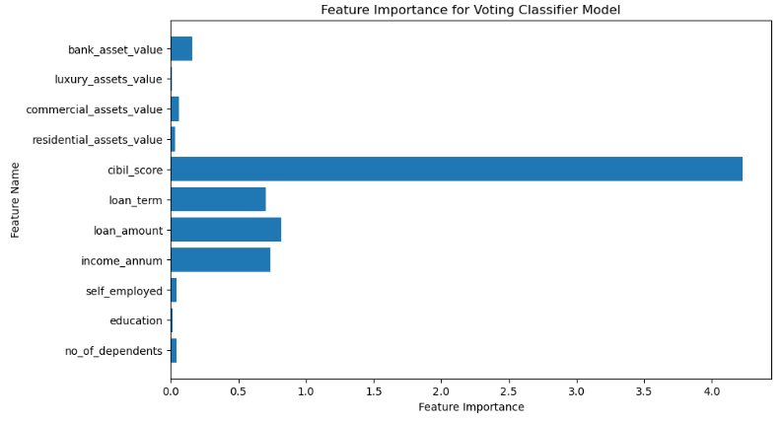
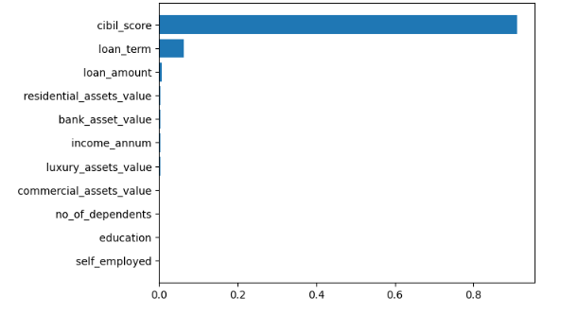
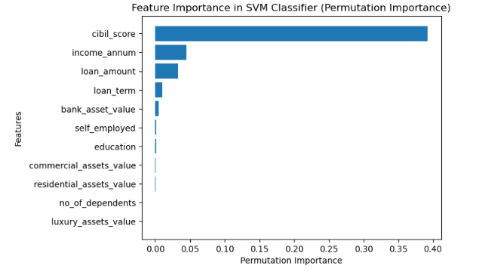
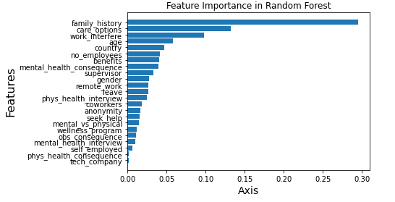
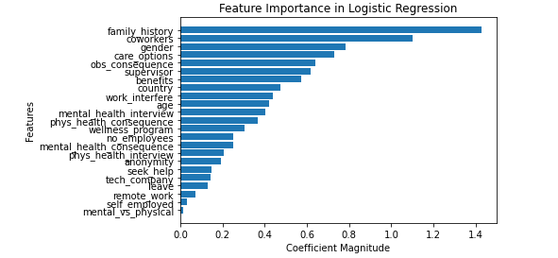
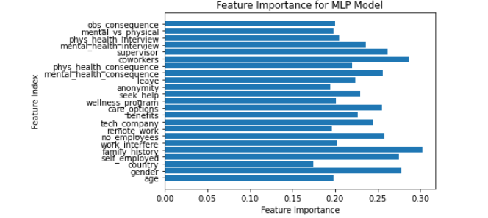
Result and Evaluation – Feature Importance Analysis

Slide 10
Conclusion
For models that can’t handle class imbalance, the use of class weights was able to eradicate any form of bias and solve the class imbalance problem.
Machine learning models relatively performs better that deep learning models except for multilayer class model which perform better than KNN model in the loan approval prediction.
The analysis of feature importance for the top three best performing models for the loan approval dataset shows that loan amount, loan annum and loan term are the most important factors that influence that model's decision making.
The analysis of feature importance for the top three best performing models for mental survey dataset shows that loan amount, loan annum and loan term are the most important factors that influence that model's decision making.
Limitations
This research fails to carry out parameter tuning of the deep learning model like radial basic function to improve its efficiency also, other deep learning algorithms was not utilized in this research.
Future Work
Future research should consider several other deep learning algorithms and focus on parameter tuning to give a more accurate algorithm.

Slide 11
References
Alagic, A., Zivic, N., Kadusic, E., Hamzic, D., Hadzajlic, N., Dizdarevic, M. and Selmanovic, E., 2024. Machine Learning for an Enhanced Credit Risk Analysis: A Comparative Study of Loan Approval Prediction Models Integrating Mental Health Data. Machine Learning and Knowledge Extraction, 6(1), pp.53-77
Kumar, C.N., Keerthana, D., Kavitha, M. and Kalyani, M., 2022, June. Customer Loan Eligibility Prediction using Machine Learning Algorithms in Banking Sector. In 2022 7th International Conference on Communication and Electronics Systems (ICCES) (pp. 1007-1012). IEEE
Kumari, Sonali & Swapnesh, Debasish & Nayak, Debasish & Swarnkar, Tripti. (2023). LOAN ELIGIBILITY PREDICTION USING MACHINE LEARNING: A COMPARATIVE APPROACH. 3. 48-54.
Uddin, N., Ahamed, M.K.U., Uddin, M.A., Islam, M.M., Talukder, M.A. and Aryal, S., 2023. An ensemble machine learning based bank loan approval predictions system with a smart application. International Journal of Cognitive Computing in Engineering, 4, pp.327-339.
Vos, J., Roberts, R. and Davies, J., 2019. Mental health in crisis. Sage.

Slide 12


